Slide 1
Introduction to Waterfall Project Model
Digital T-Level – Software Testing

Slide 2
Today
Linear and evolutionary project management
Waterfall Project management
Software testing in waterfall model

Slide 3
Linear Software Project Development
There are many lifecycle models.
Historically, the waterfall method has been the popular choice.
The waterfall methodology is known as a linear development lifecycle model.
In the waterfall approach, the requirements are set, and do not change throughout the life of the project.

Slide 4
Linear Models & Software Development
The linear approach is very good for projects where the requirements will not significantly change.
Civil engineering projects, such as making a bridge, works well in a linear development cycle.
Software development does not lend itself to the linear approach – why?

Slide 5
Stages of a Waterfall Project
The six main sections of a waterfall software project management model are:
  Analysis
  Requirements Specification (requirements engineering)
  Design
  Development
  Testing & Integration
  Implementation & Deployment
Stages can vary but will cover all the above in some form.

Slide 6
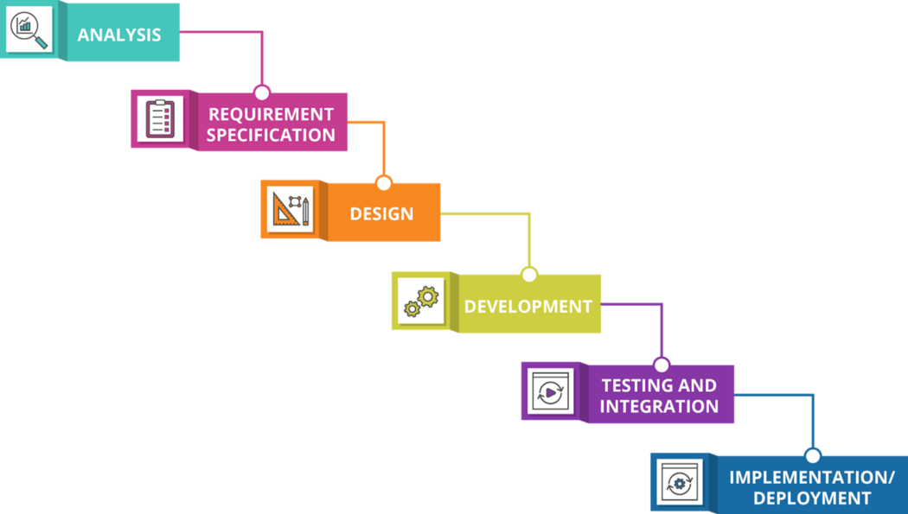
Waterfall Model
https://medium.com/@joneswaddell/the-cascading-costs-of-waterfall-5c3b1b8beaec

Slide 7
Analysis
In this section, we talk with the client and investigate the problem & processes they want solving.
During this section you would perform a feasibility study.
Refer to your lesson notes from Laurence’s project management lessons.
Remember that this unit is concerned with software testing and how that fits into a software development project.

Slide 8
Requirements Specification
We covered this in a previous lesson, so refer to those resources, but…
Remember that requirements engineering is concerned with a consistent approach to developing a requirements specification, and…
…defining ‘good’ requirements.

Slide 9
Design
Once a clear set of agreed user requirements have been agreed. Potential designs of the product must be generated.
This must be done before the product is made.
The client must ‘sign-off’ a design before it is made.
Areas that the design should cover include:
  The user interface that will be provided.
  The general structure of the program – how will the code be laid out.
  Detailed design that show how procedures will carry out the required tasks.
  Diagrams that will show how the program will ‘flow’.
  How data will be stored by the system.

Slide 10
Development
During this stage the product is developed (coded)
In a waterfall project, only development takes place at this stage
  No testing
  No tweaks to designs

Slide 11
Testing
Before a product can be handed over to the client it must be tested.
Testing is to find if the product is ‘fit for purpose’.
Testing must cover every part of the system.
Refer back to the previous lessons for a refresher about different types and phases of testing.
Testing is often referred to
  Alpha Tests
  Beta Tests

Slide 12
Alpha Testing
Alpha testing is done within the software development company.
It is also referred to as ‘in-house testing’.
The testing is performed by developers and software testers that are employed by the development company.
Any bugs or errors are fixed upon detection.

Slide 13
Beta Testing
Beta testing carried out by a limited number of external users.
Beta testing takes place when a product has been tested by the development house.
Beta testing subjects a product a small-scale (and often time limited) real-life test.
Quite often bugs will be found that the development team missed.
Acceptance testing with ‘Smoke Testing’

Slide 14
Implementation/Deployment
Once a product has been signed-off it can be deployed.
The product is either:
  Implemented into a current system
  Or, is a completely new system that is deployed…
  …deployment can take several forms, but that is for another unit.

Slide 15
Waterfall Characteristics
Defined and ‘boxed’ stages with…
Clear start and end dates.
Stages (or phases) do not overlap…
…the first stage needs to be 100% complete, before moving on to stage 2, etc.
If phase end date is met and is not 100% complete…
…the end date ‘slips’, which pushes the start date for the next phase back, which will lead to knock-on effects throughout the rest of the project.

Slide 16
Evolutionary Software Development
In the late 1990’s new methodologies for software development where developed.
From these the current approach to software design was born – Agile.
Agile is an iterative model, which acknowledges the fact that requirements for software products will change.
So regular iterations of the product is made.
We will look at Agile next.

Slide 17
Waterfall Advantages & Disadvantages
In the activity, you will need to compile a list of both positive and negative points of adopting a waterfall approach to developing software projects.
When completing this activity, remember to relate it to software testing.

